Slide 1



Internship Interview
AI-Driven Disease Progression Modeling for Parkinson's Disease Bridging Clinical Phenotypes and Molecular Pathways
Internship project
Patient stratification • Longitudinal clustering • Fairness-Aware algorithm
Presented by :
Moad Hani, MSc
PhD Research and Teaching Assistant | University of Mons (UMONS), Belgium
Expected Defense: September 2026
moad.hani@umons.ac.be

Slide 2
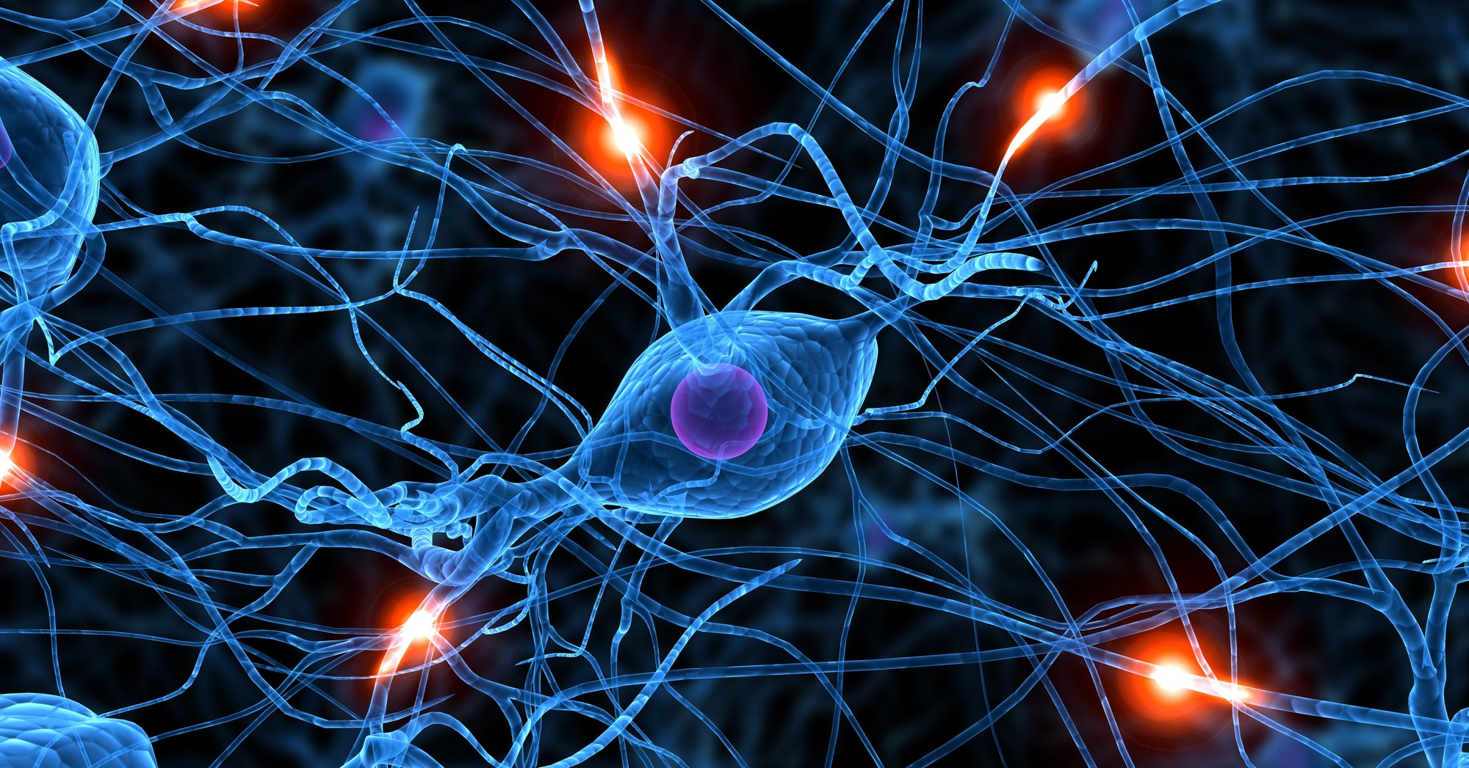
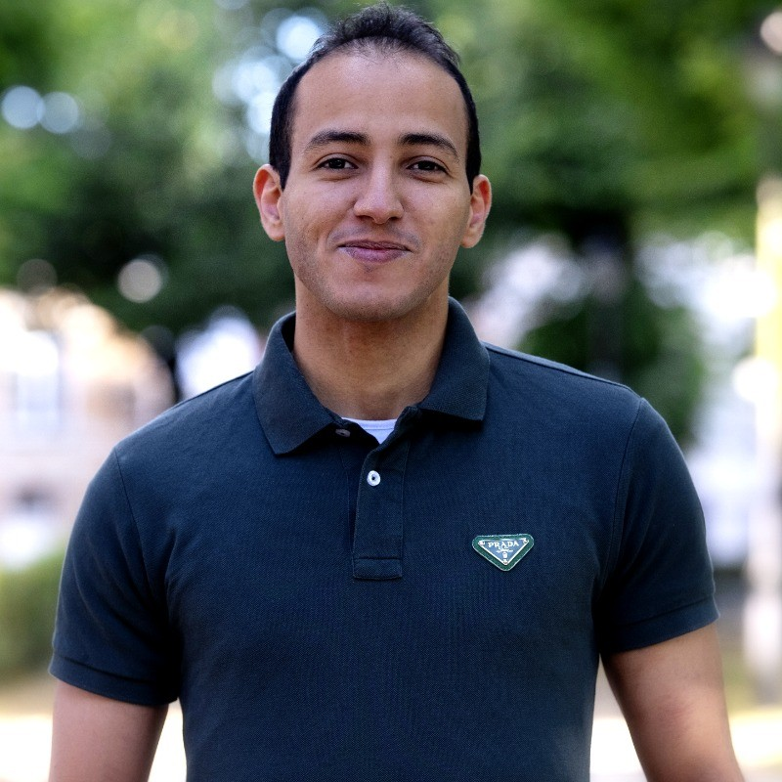
About Me
PhD in AI & Medical Informatics (UMONS, Belgium):
Expected Defense: September 2026
Thesis: "AI-Driven Stratification of Neurodegenerative Disease Progression"
Supervisors: Prof. Mohammed Benjelloun, Prof. Saïd Mahmoudi
Recognition & Funding:
3 Research Grants (2025): [Infortech / Numediart / CRECHE]
Horizon Europe Grant (2023): AI for Healthcare 2030
Diplomas: AI for Digital Healthcare (ULB), Deep Unsupervised Learning (Oxford)
Teaching & Mentorship:
230 hours/year: Machine Learning, Data Mining, Programming
Supervised 3 Master's thesis projects (2023-2025)
Moad Hani
LIH
Internship Interview
2

Slide 3
About Me
SOTHEMA Morocco (2019-2020)
Pharmaceutical sales forecasting with ML
Impact: 18% improvement in demand prediction accuracy
Skills: Time-series analysis, business analytics, stakeholder communication
Core Technical Expertise
Longitudinal modeling: SuStaIn, mixed-effects models, survival analysis
Deep learning: VAEM, GAIN, HyperImpute, VADER (imputation)
Multi-omics integration: Clinical + imaging + genetic + biological data
Statistical rigor: Bayesian inference, cross-validation, fairness metrics
Domain Knowledge (PD-Specific)
Clinical scales: MDS-UPDRS, MoCA, SCOPA-AUT, H&Y staging
Genetic factors: GBA, LRRK2
Molecular pathways: Insulin signaling (FOXO1/3), mitophagy, autophagy
Cohorts: PPMI (1,358 patients), AMP-PD
Moad Hani
LIH
Internship Interview
3

Slide 4
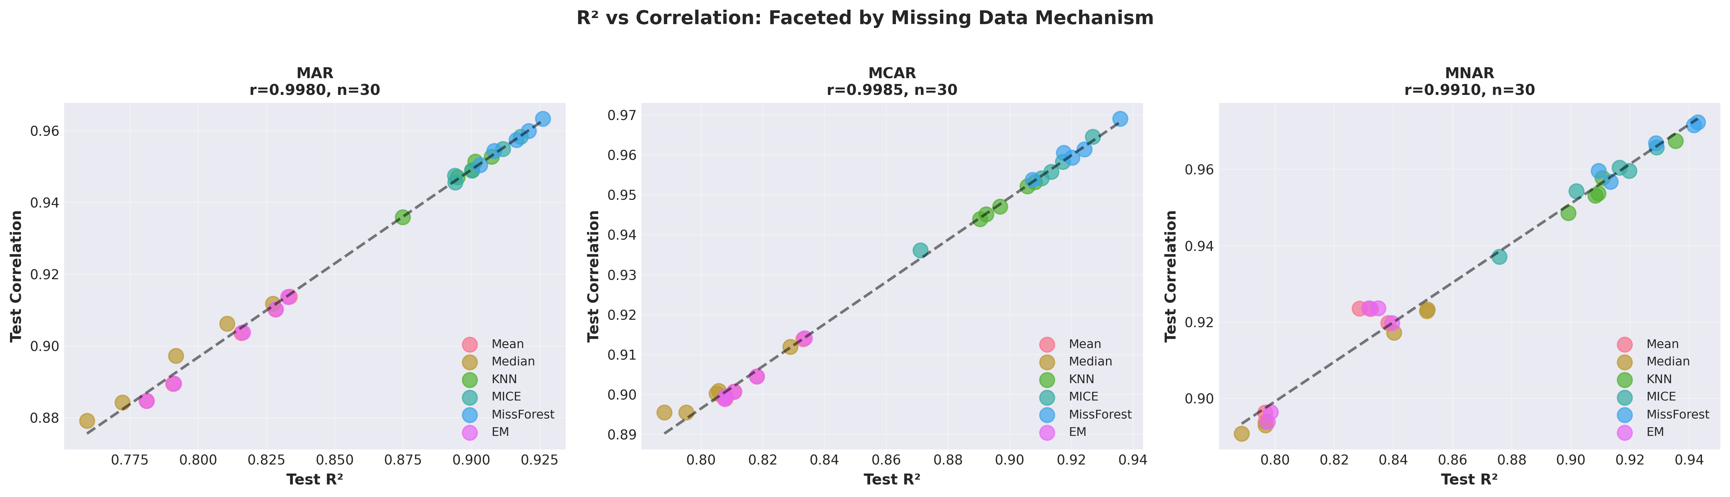
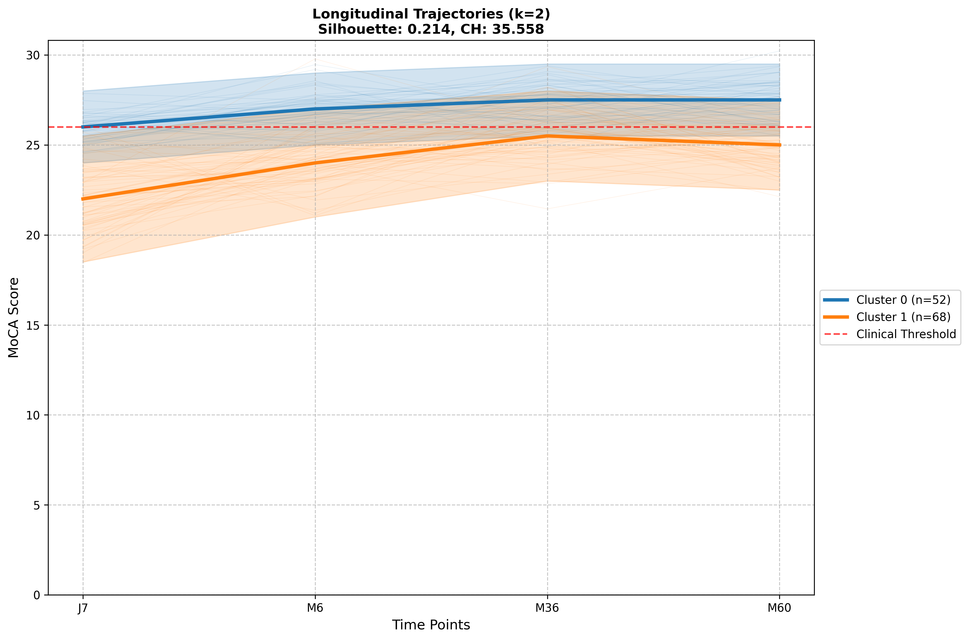
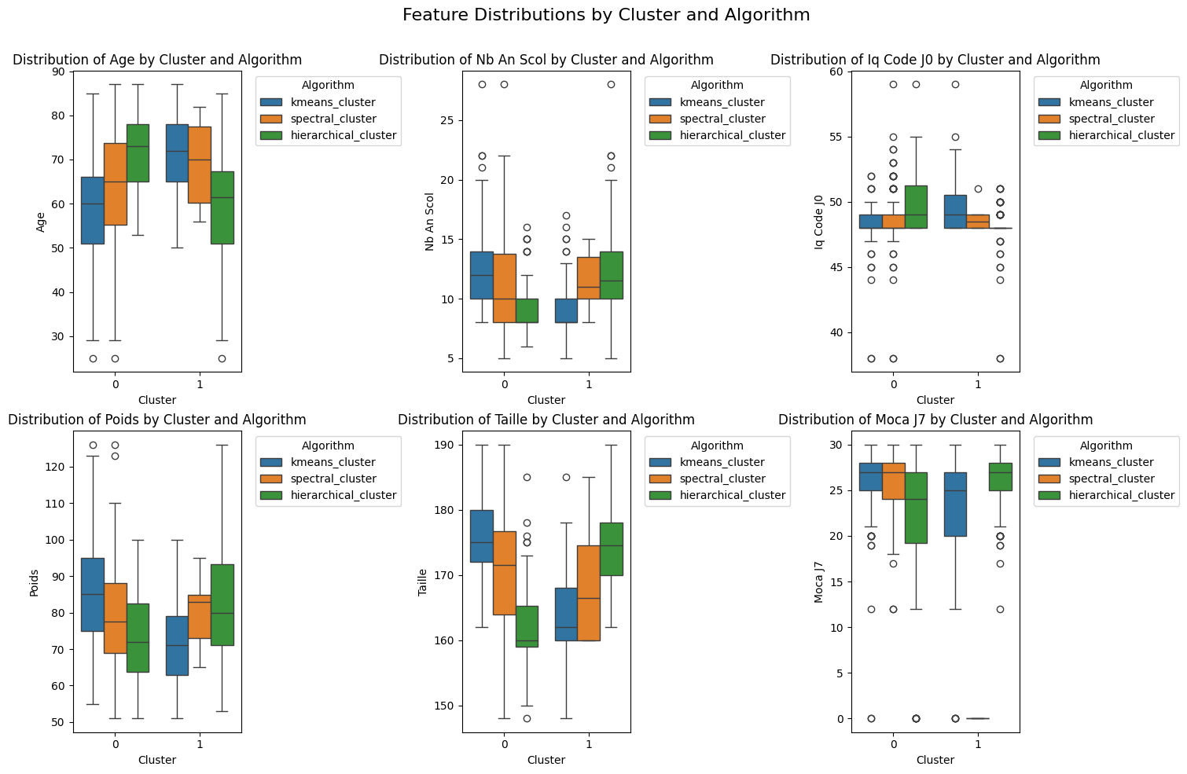
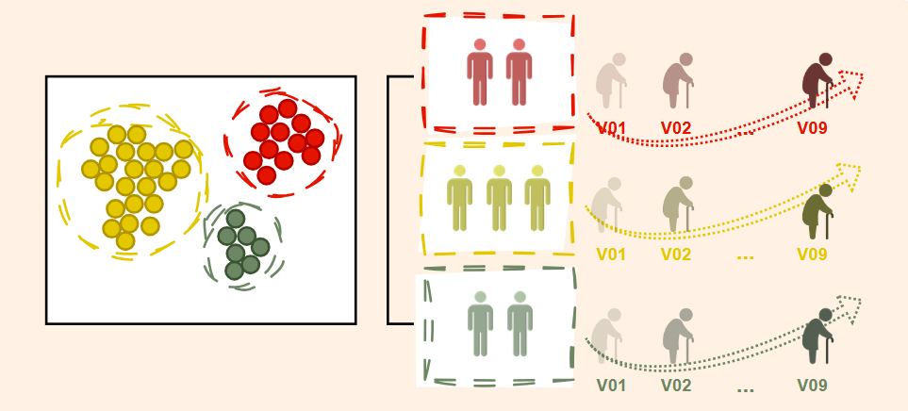
Selected Papers
Context-aware deep learning imputation [Hani et al.]
Optimization-Driven Clustering for Stroke Recovery Trajectories [Hani et al.]
Longitudinal subtyping and substaging of PD patients [Hani et al.]
LIH
Internship Interview
4

Slide 5
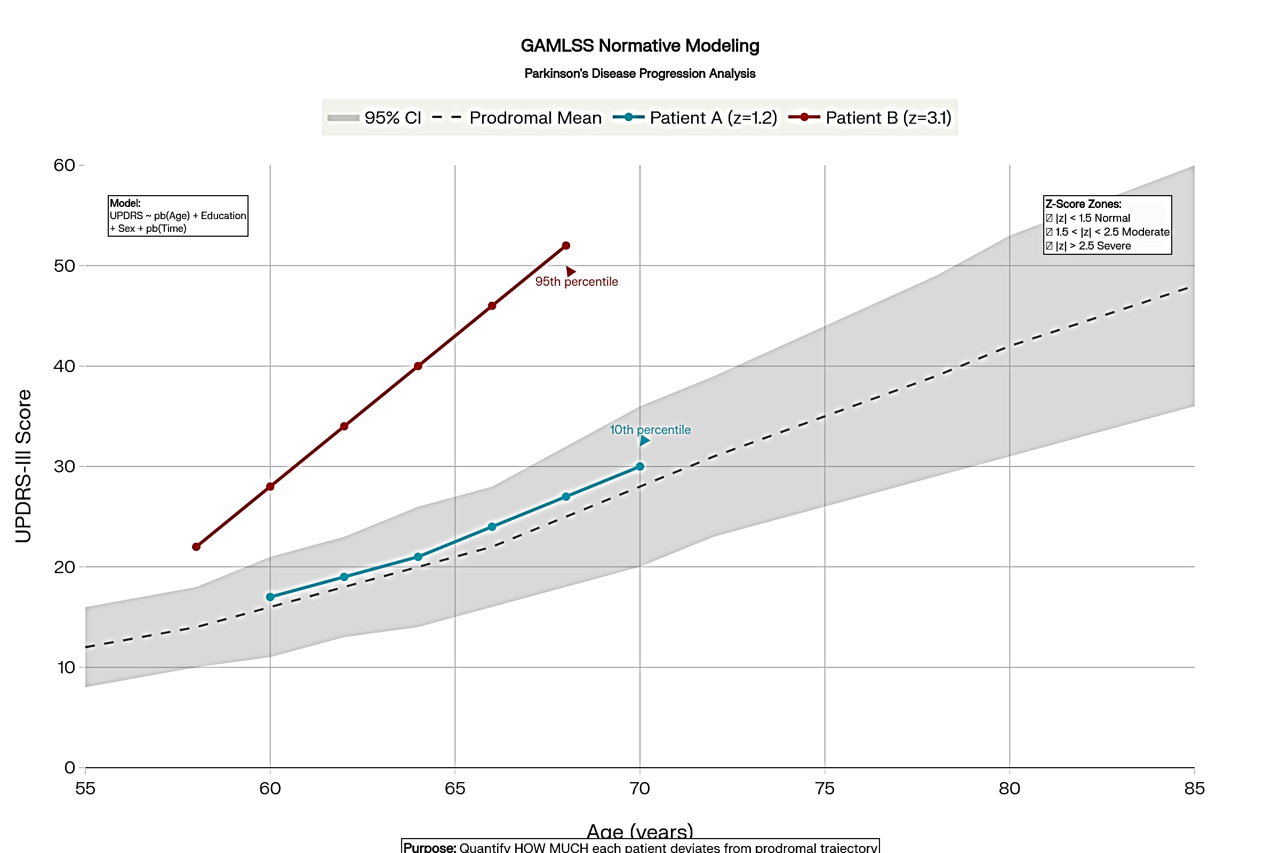
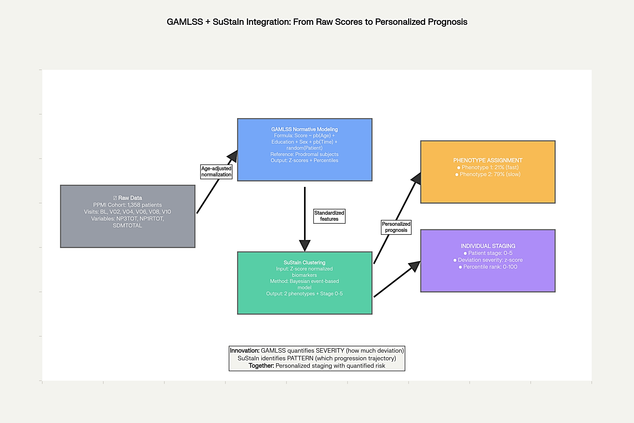
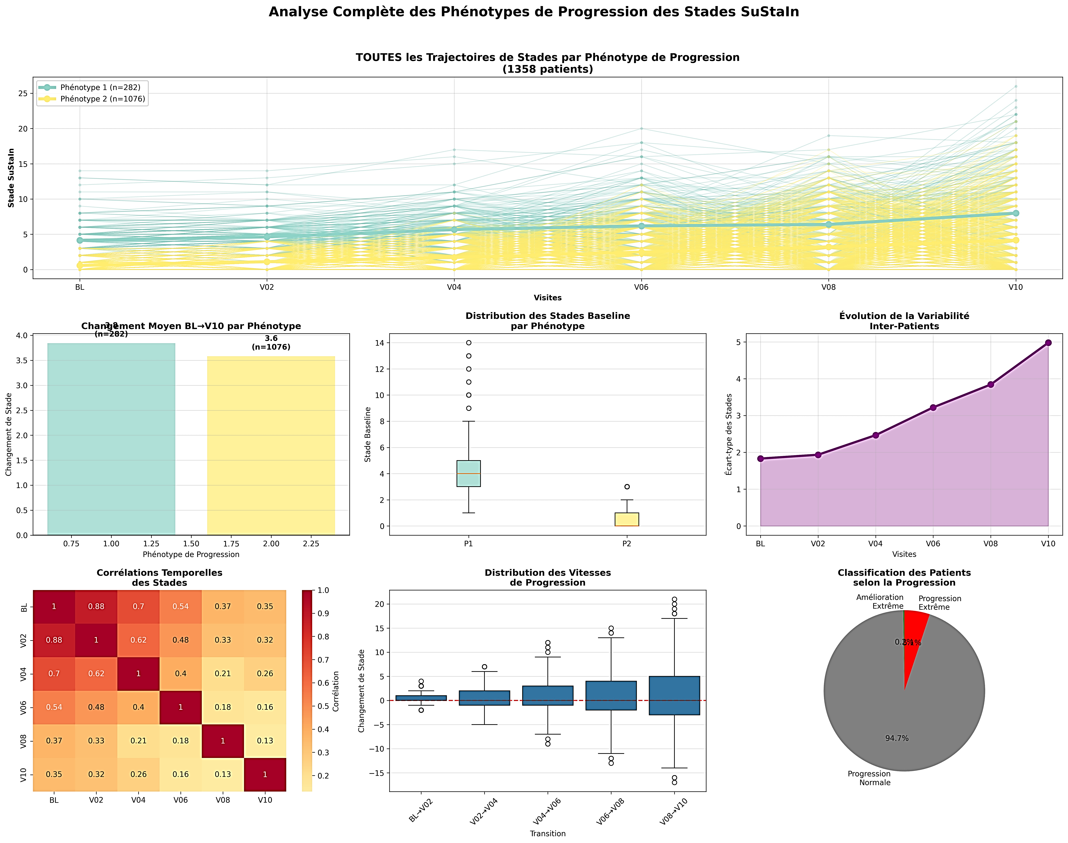
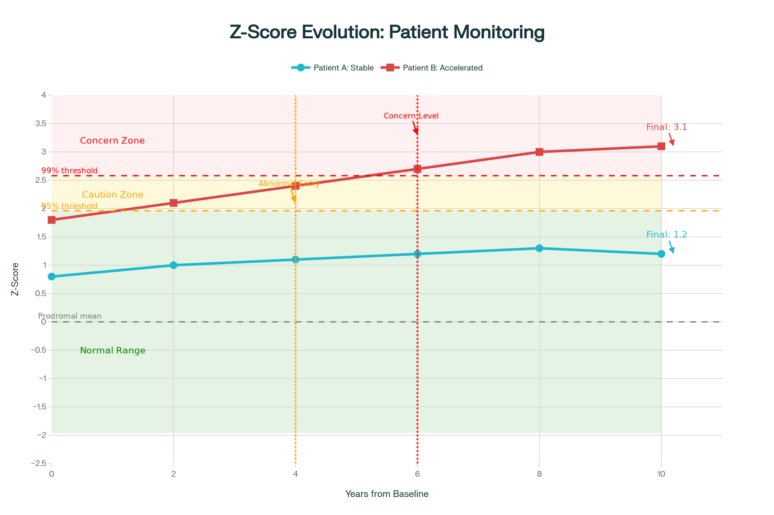
Thesis Highlights
LIH
Internship Interview
5

Slide 6
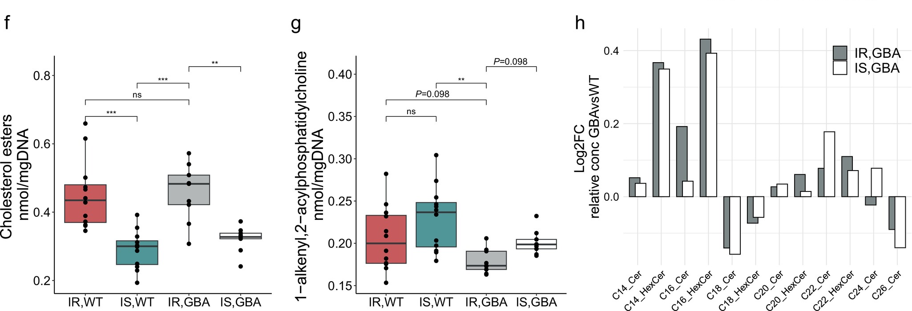
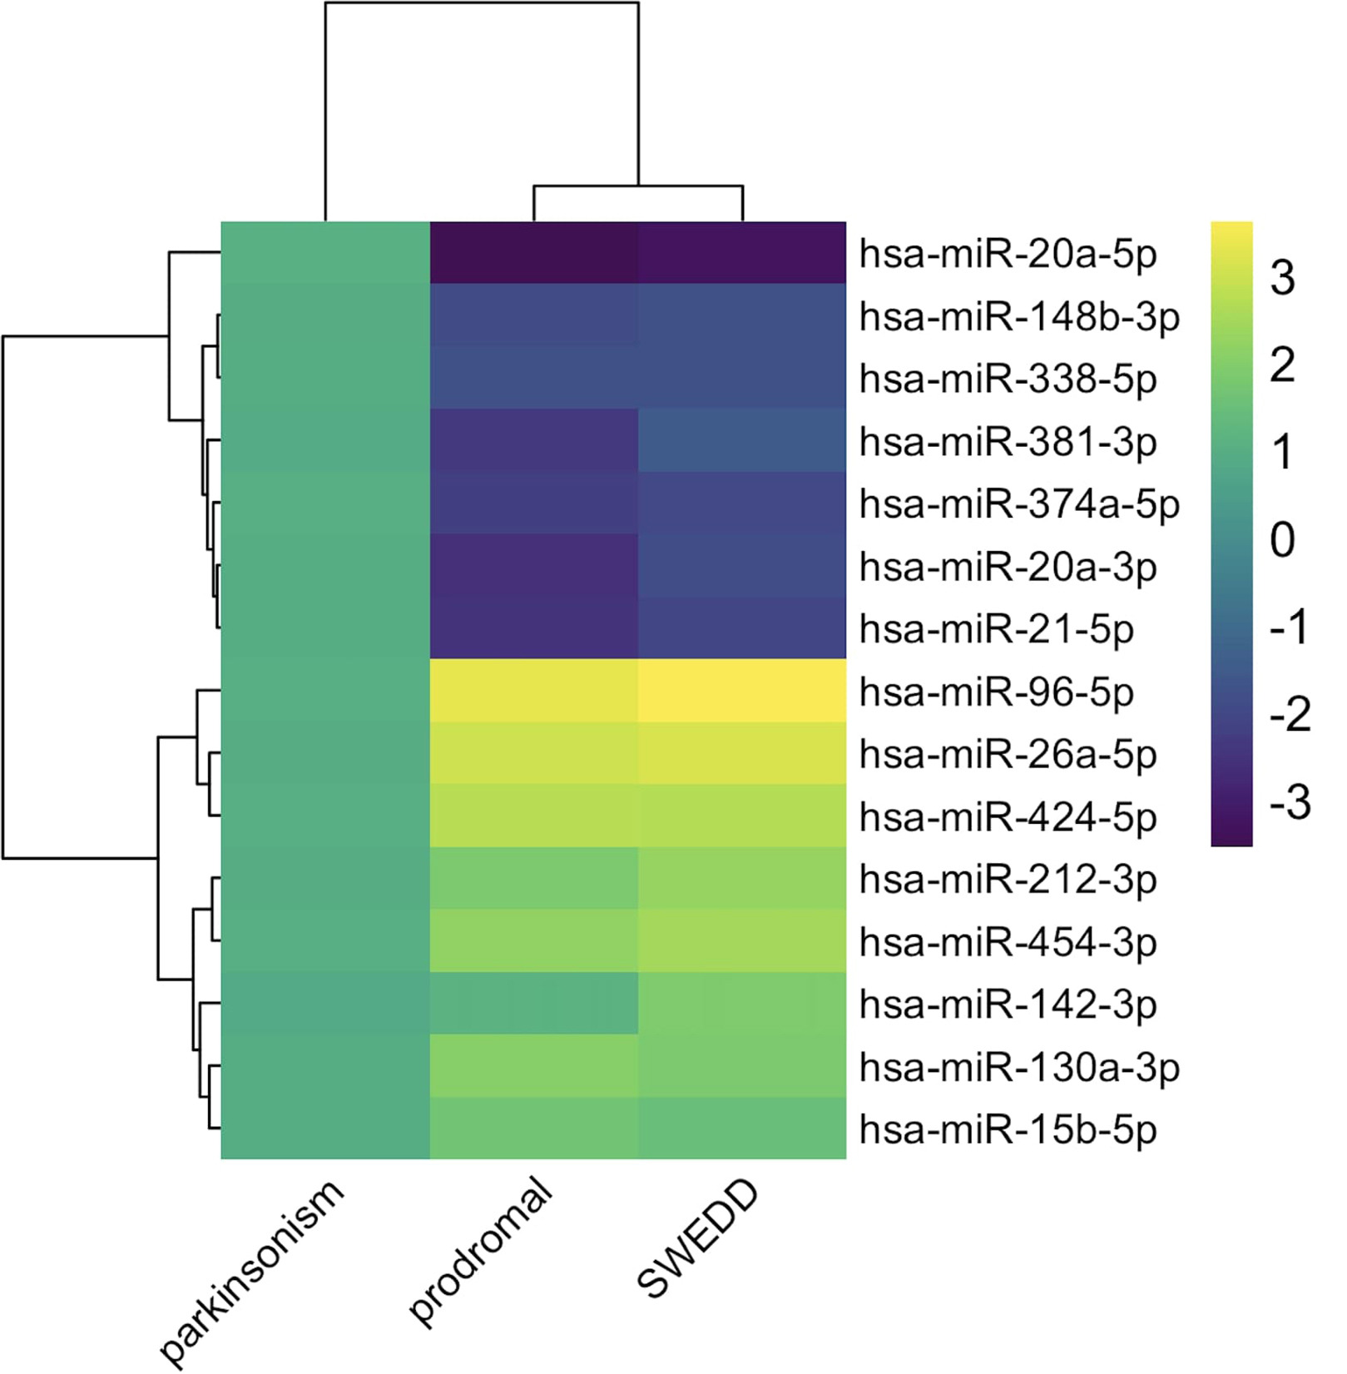
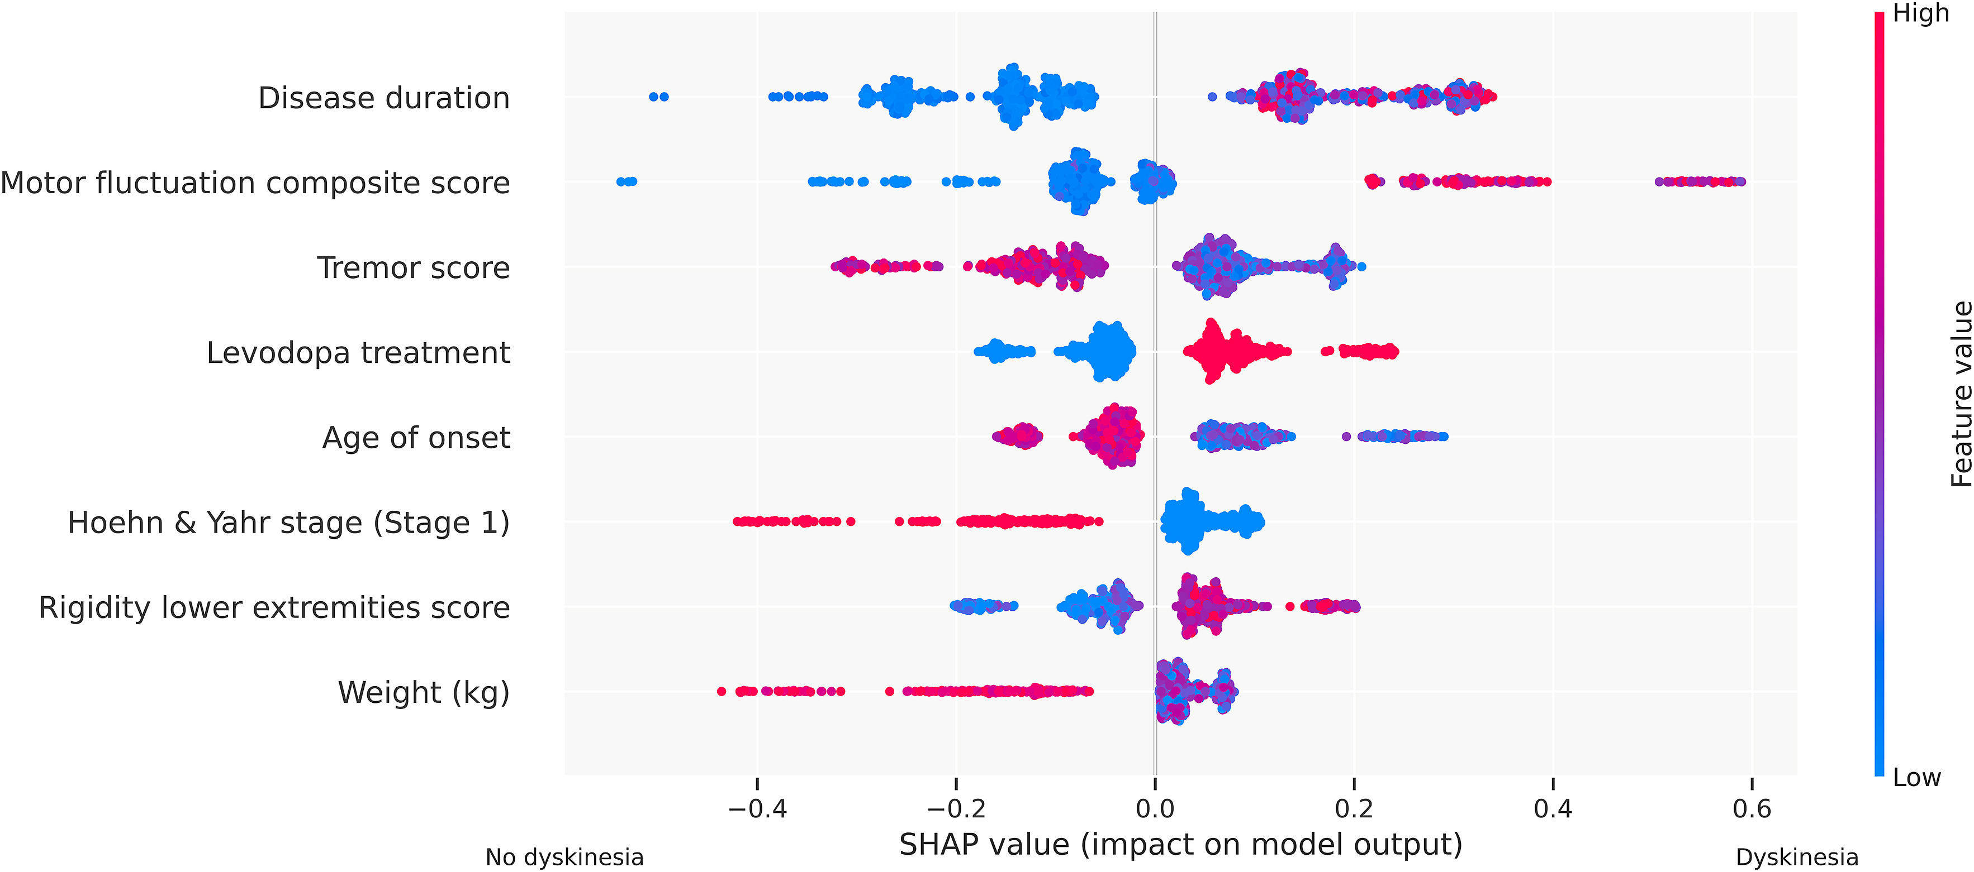
Connecting My Work to LIH’s Research
PAPER 2: Zagare et al. (Movement Disorders 2024)
PAPER 1: Dr. Hemedan Hemedan et al. (iScience 2024)
PAPER 3: Loo et al. (Parkinsonism & Related Disorders 2024)
LIH
Internship Interview
6

Slide 7
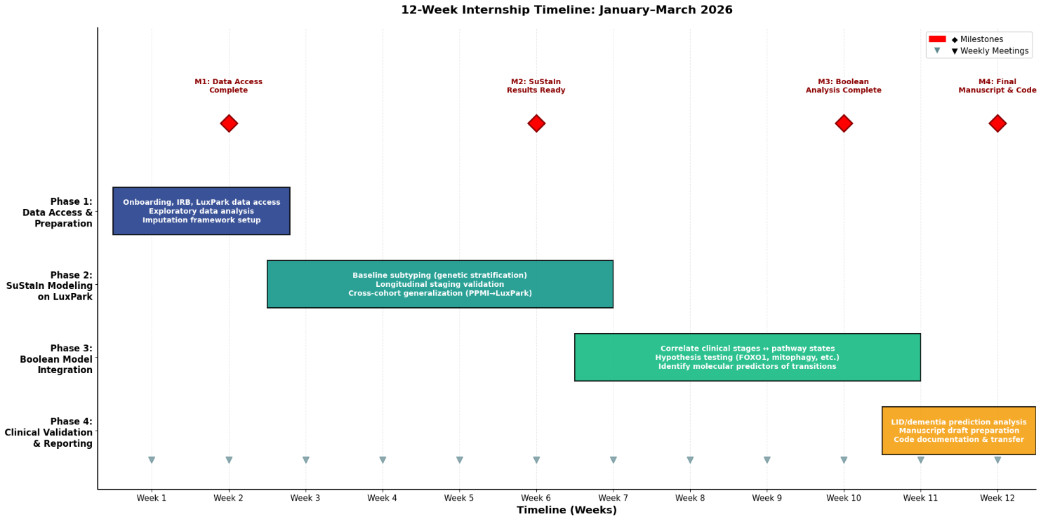
12-Week Internship Roadmap
LIH
Internship Interview
7

Slide 8
Future Directions
What I’ll do next:
Benchmark SuStaIn variants on LuxPark: Which model structure best captures PD heterogeneity in this cohort?
Add biological features: Can miRNA profiles or GBA variant severity improve subtyping?
XAI for interpretability: Use attention mechanisms to identify which biomarkers drive subtype assignment
Reliability: Address class imbalance (some subtypes may be rare), calibrate probabilistic outputs
What I’ll bring as an Intern :
A transferable skill set: Longitudinal modeling, imputation, reproducible pipelines
Collaboration mindset: I've worked with clinicians, bioinformaticians, and geneticists and know how to communicate across disciplines
Proactive learning: I've already taught myself Boolean modeling concepts from your papers; I'll continue learning systems biology from your team
Expected outputs:
Short-term: Internal validation report for LIH/NCER-PD
Medium-term: Co-authored paper integrating SuStaIn + Boolean models (submission target: Q2 2026)
Long-term: Building the foundation for a future postdoctoral collaboration at LIH.
LIH
Internship Interview
8

Slide 9
Thank you !
LIH
Internship Interview
9

Slide 10
Internship Interview
AI-Driven Disease Progression Modeling for Parkinson's Disease Bridging Clinical Phenotypes and Molecular Pathways
Internship project
Patient stratification • Longitudinal clustering • Fairness-Aware algorithm
Presented by :
Moad Hani, MSc
PhD Research and Teaching Assistant | University of Mons (UMONS), Belgium
Expected Defense: September 2026
moad.hani@umons.ac.be

Slide 11
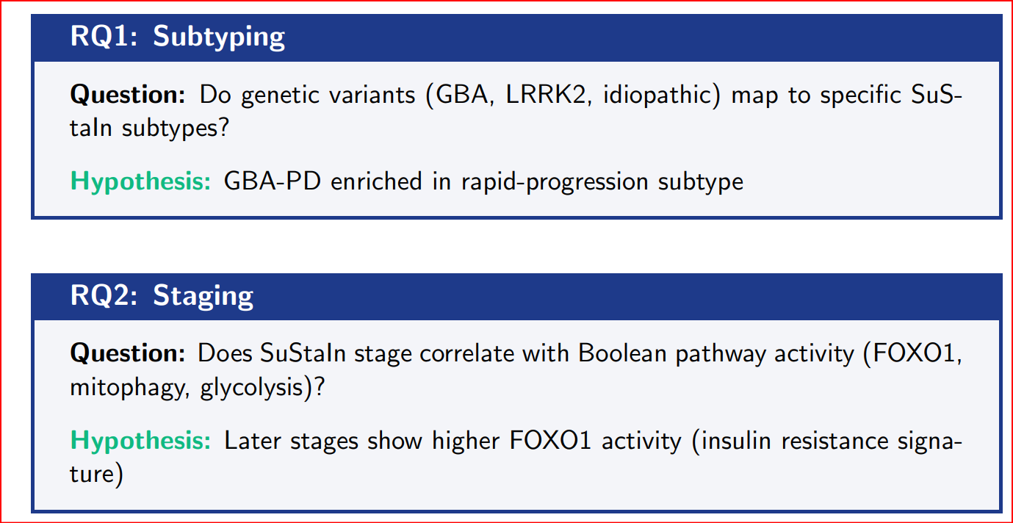
Research Questions
LIH
Internship Interview
11

Slide 12
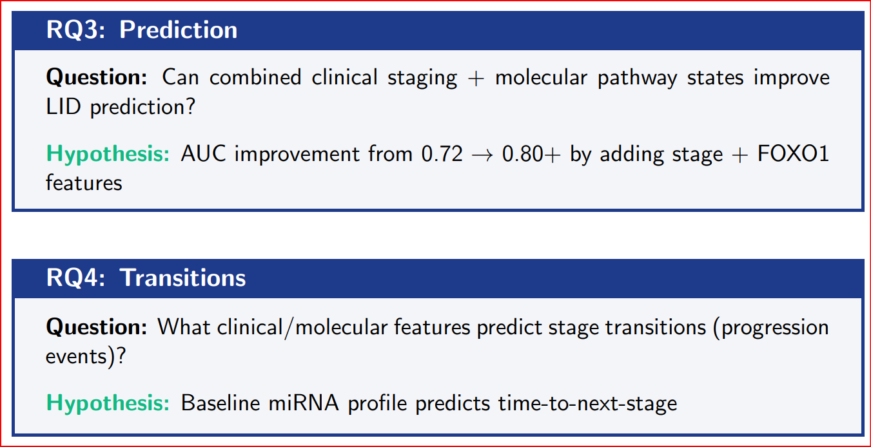
Research Questions (Continued)
LIH
Internship Interview
12

Slide 13
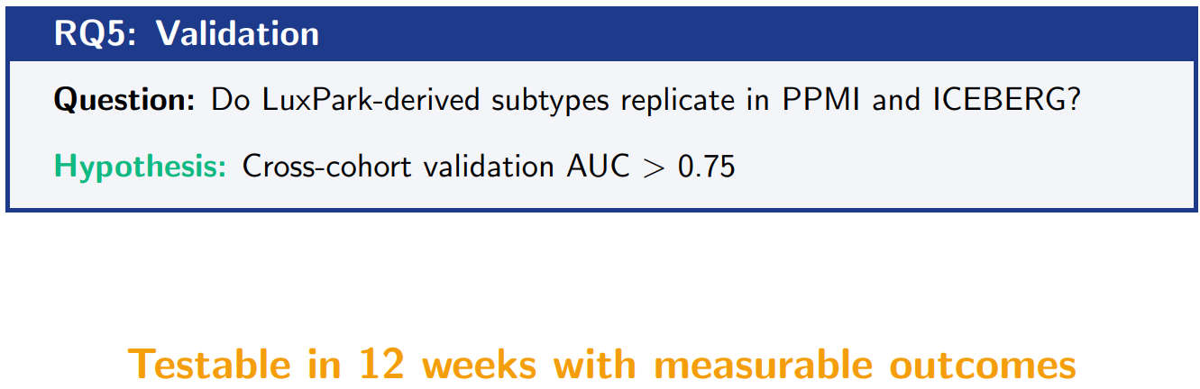
Research Questions (Continued)
LIH
Internship Interview
13

Slide 14
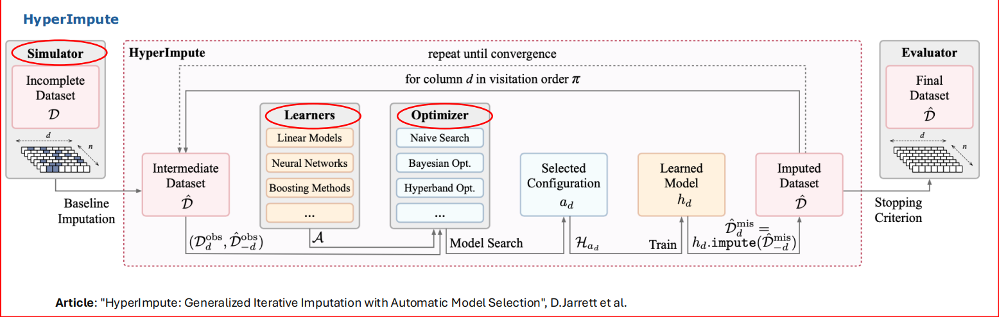
HyperImpute
LIH
Internship Interview
14

Slide 15
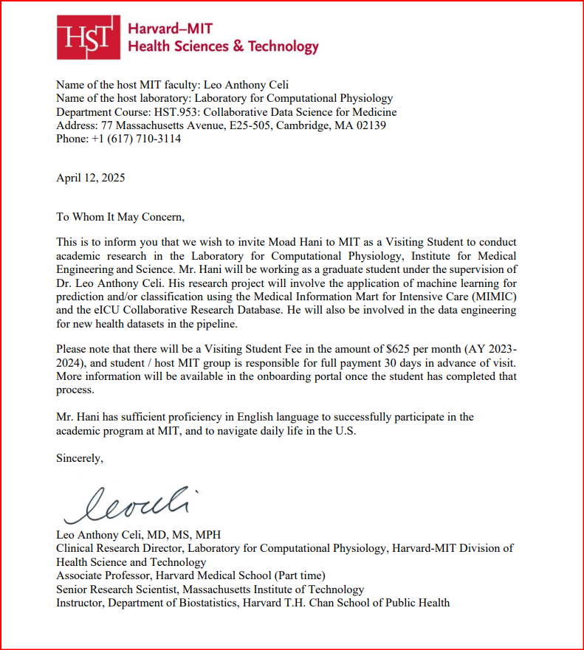
Dr. Leo Celi invite
LIH
Internship Interview
15

